Slide 1

MicroPython: The fast track to an IOT hellscape
Keith Harris

Slide 2
What we’ll do:
Introduction
A Closer Look at MicroPython
The Quick Start Guide
Custom Hardware + Demo
OTS Hardware + Demo

Slide 3

INTRODUCTION
Hello!

Slide 4
MicroPython:
A Closer Look

Slide 5

Who made it?
Dr. Damien P. George

Slide 6
WHAT IS IT?
“MicroPython is a lean and efficient implementation of the Python 3 programming language that includes a small subset of the Python standard library and is optimised to run on microcontrollers and in constrained environments.”
Practically: Everything the Python interpreter needs is built out in C. The C code is used to “glue” the interpreter to the bare metal.

Slide 7
What you get
-An almost full version of python 3.xx! (asyncio, multi-thread)
-A serial based REPL
-.Py Portable across boards
What you Don’t get
-Any C based python libraries (cython, ironPy, tinkr, numpy)
-Raw f-strings
-Super() implementation slightly different

Slide 8
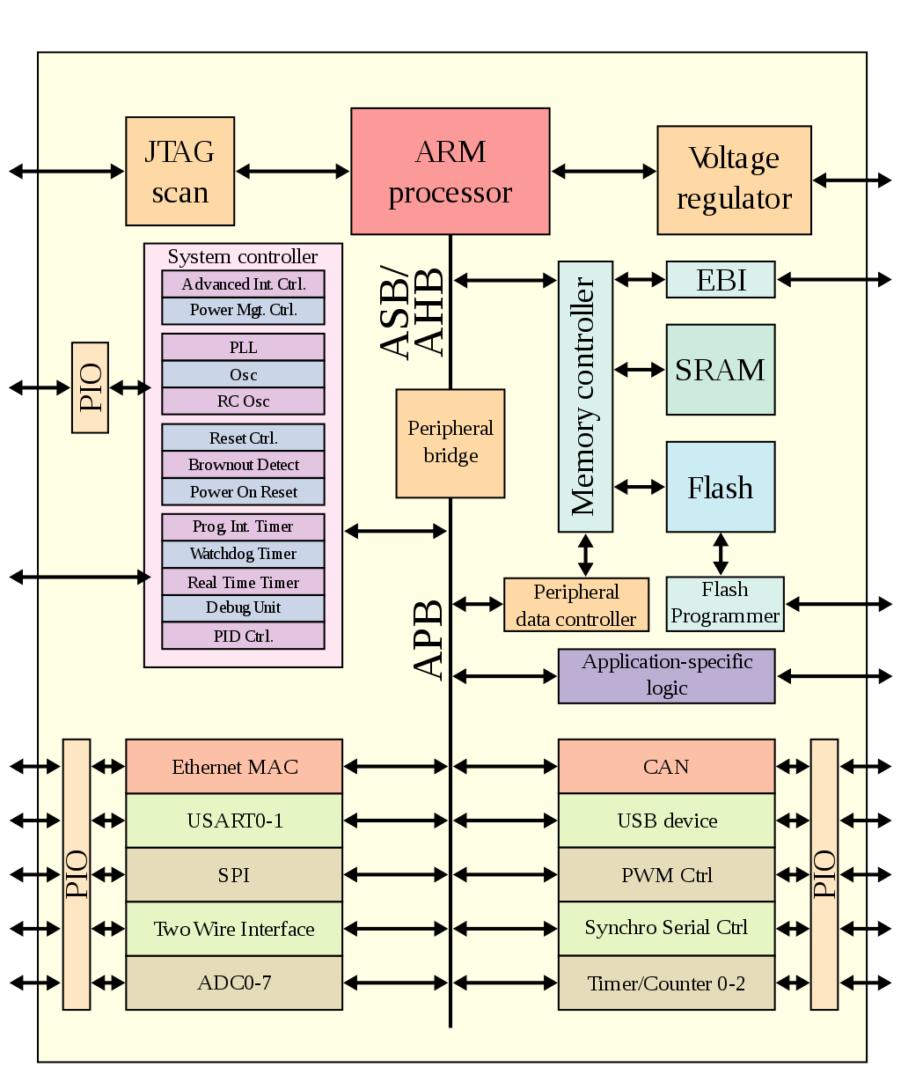
Hardware Constraints
-Any* SOC will work provided there is 2mb of memory available
-Any operation requiring low latency will be difficult (work arounds abound)

Slide 9
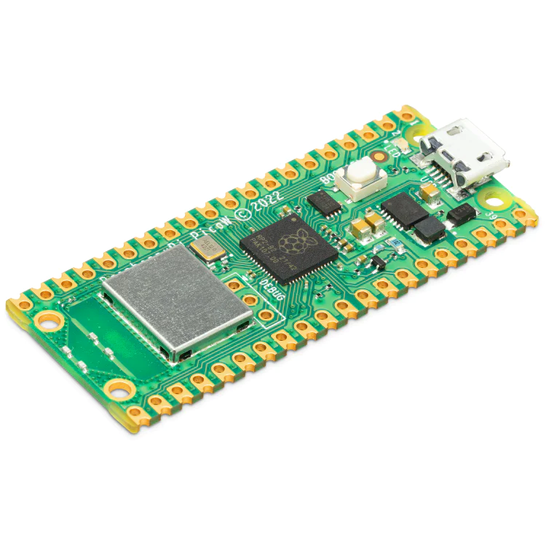
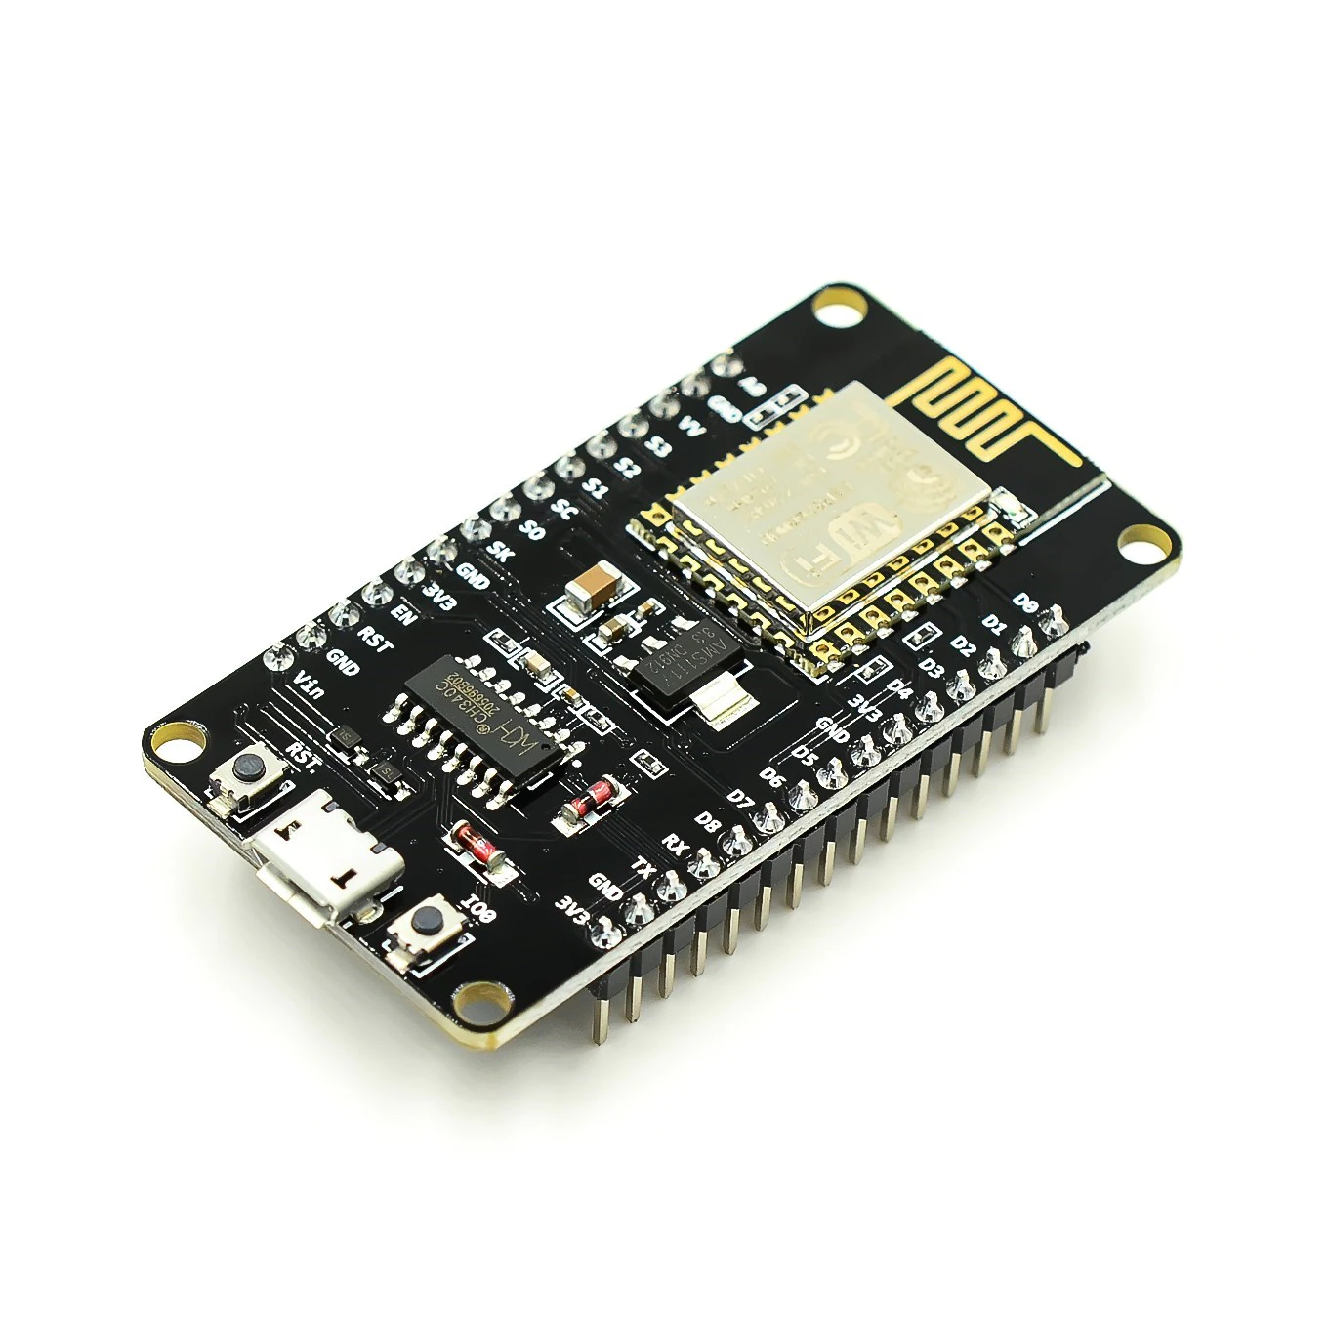
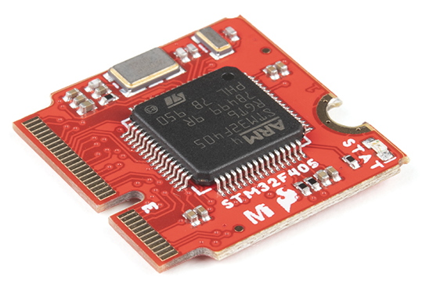
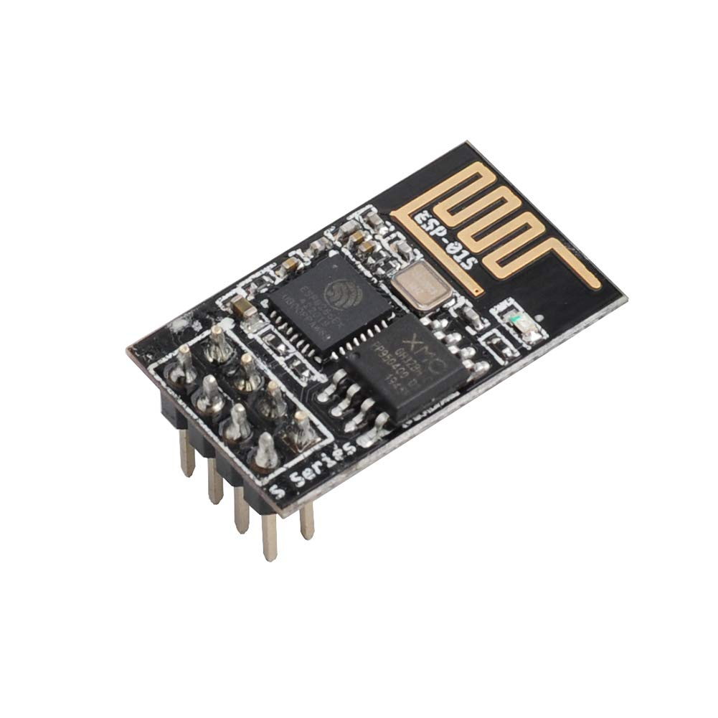
OTS Hardware
-Pico Pi, esp8266, st32, and more!

Slide 10
Application
-Fast prototyping!
-One-off applications (visual effects, proof-of –concept)

Slide 11


Applications IRL

Slide 12
MicroPython:
Quick Start Demo

Slide 14
Custom Hardware

Slide 15
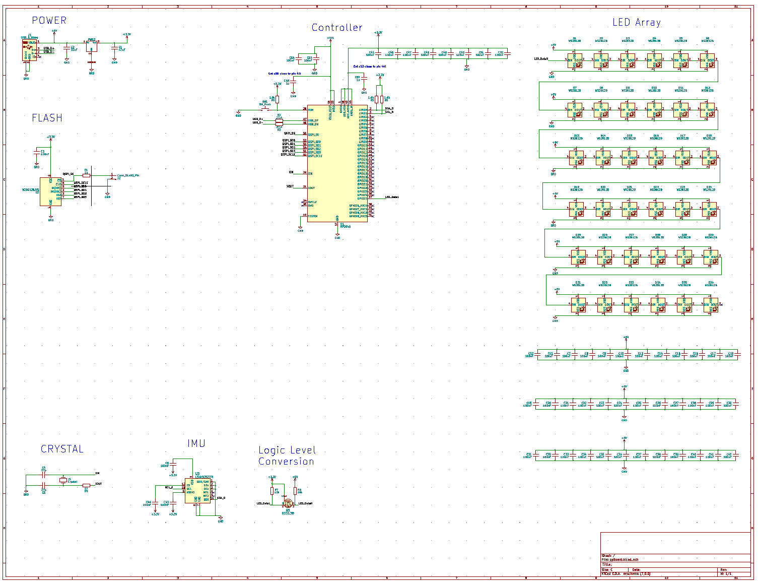
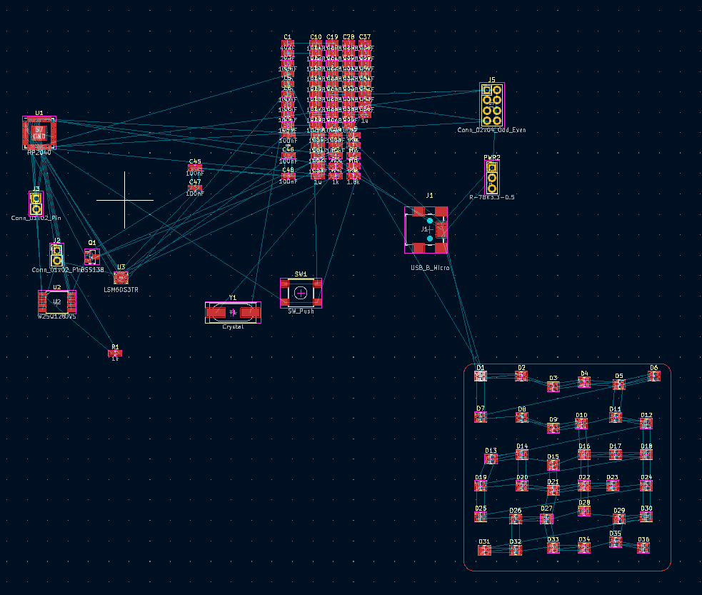
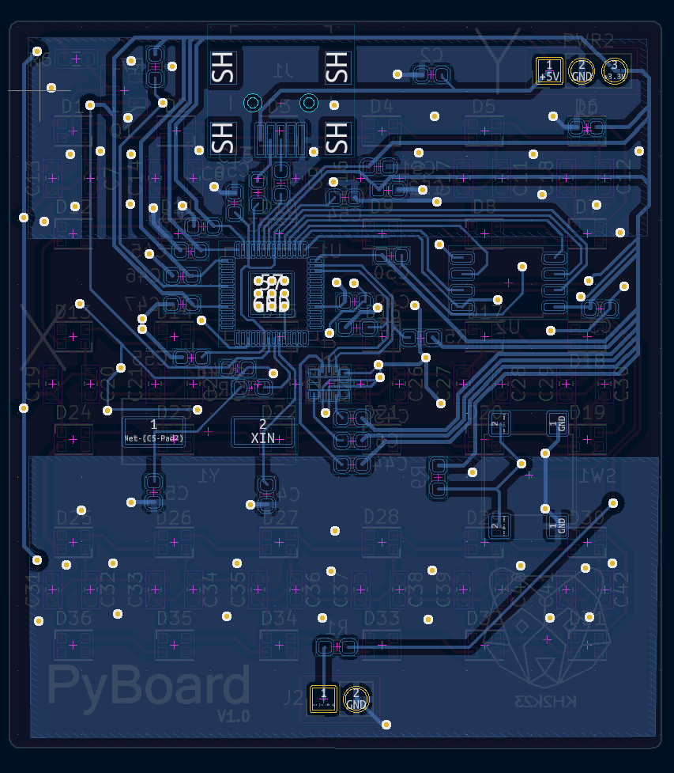
Kicad

Slide 16
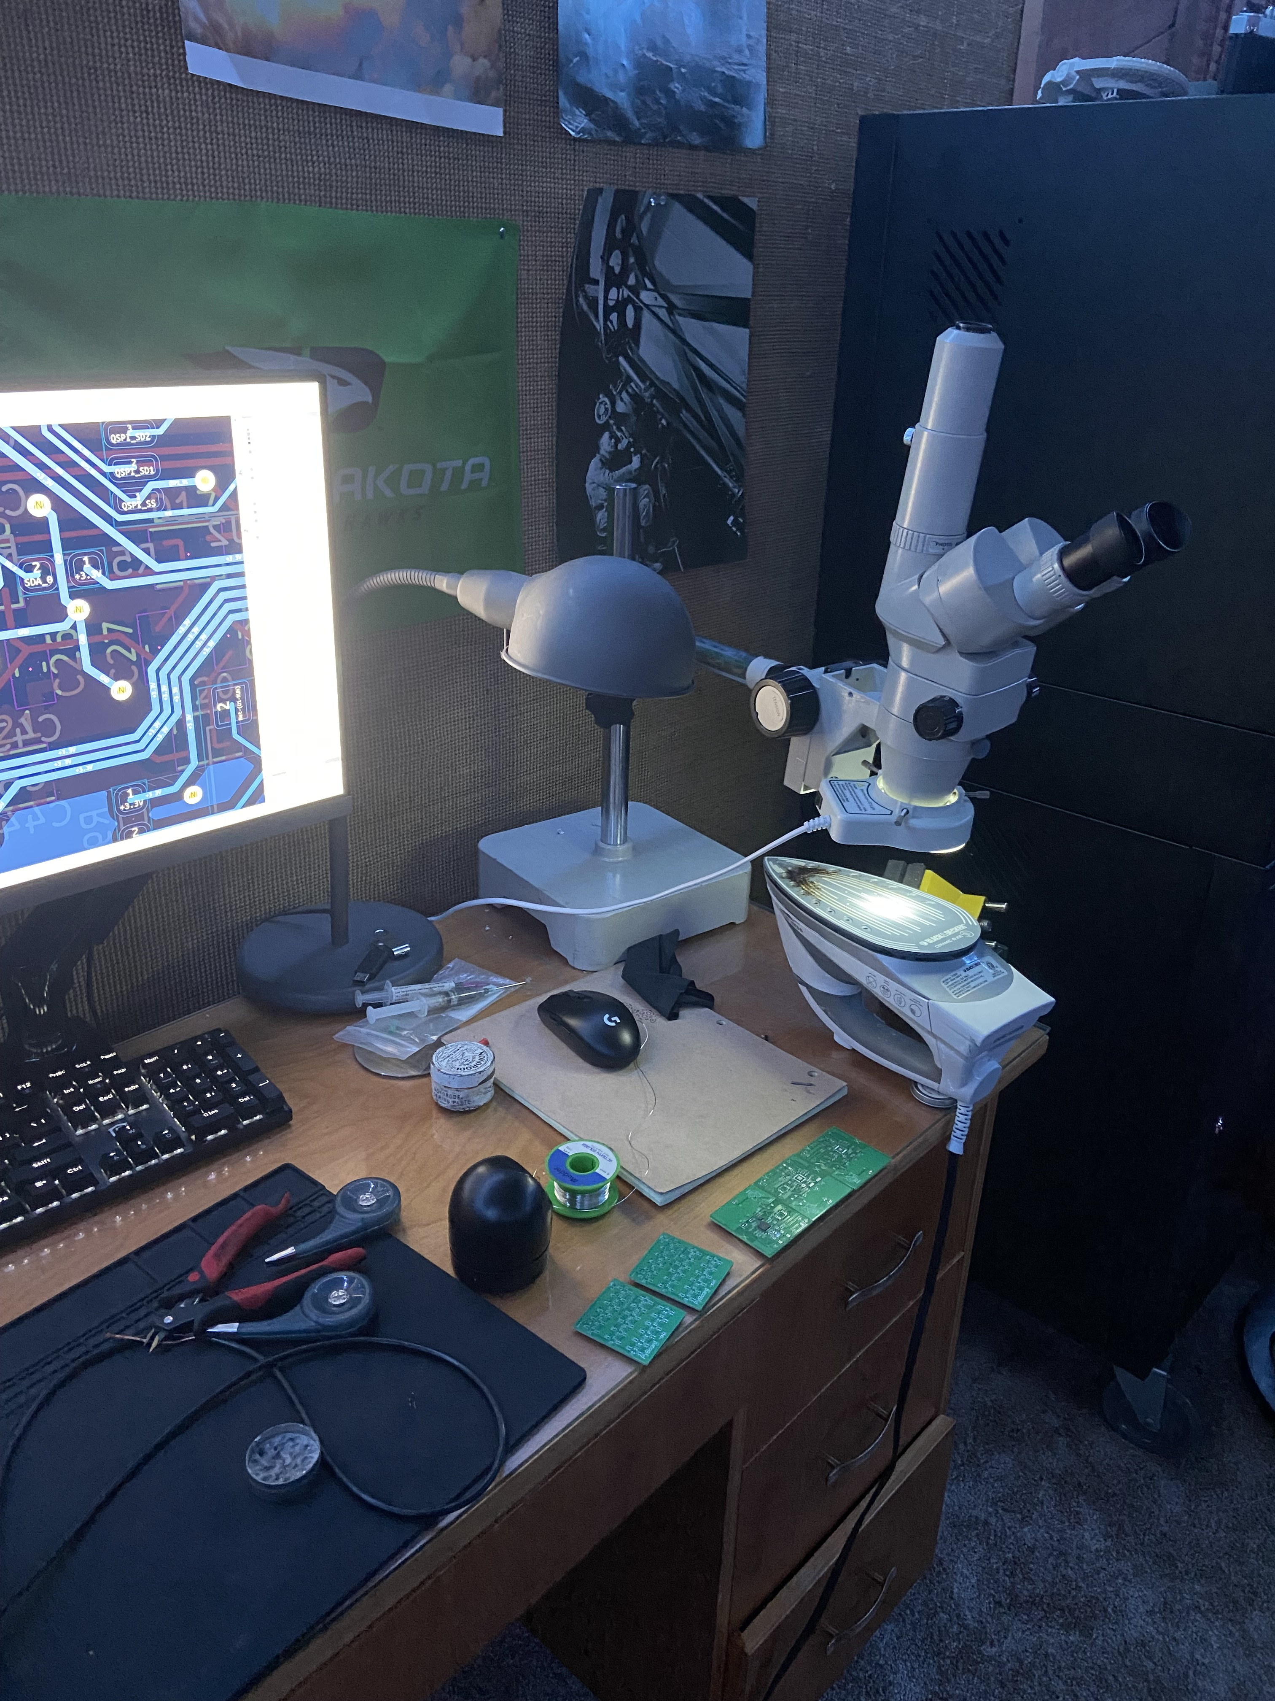
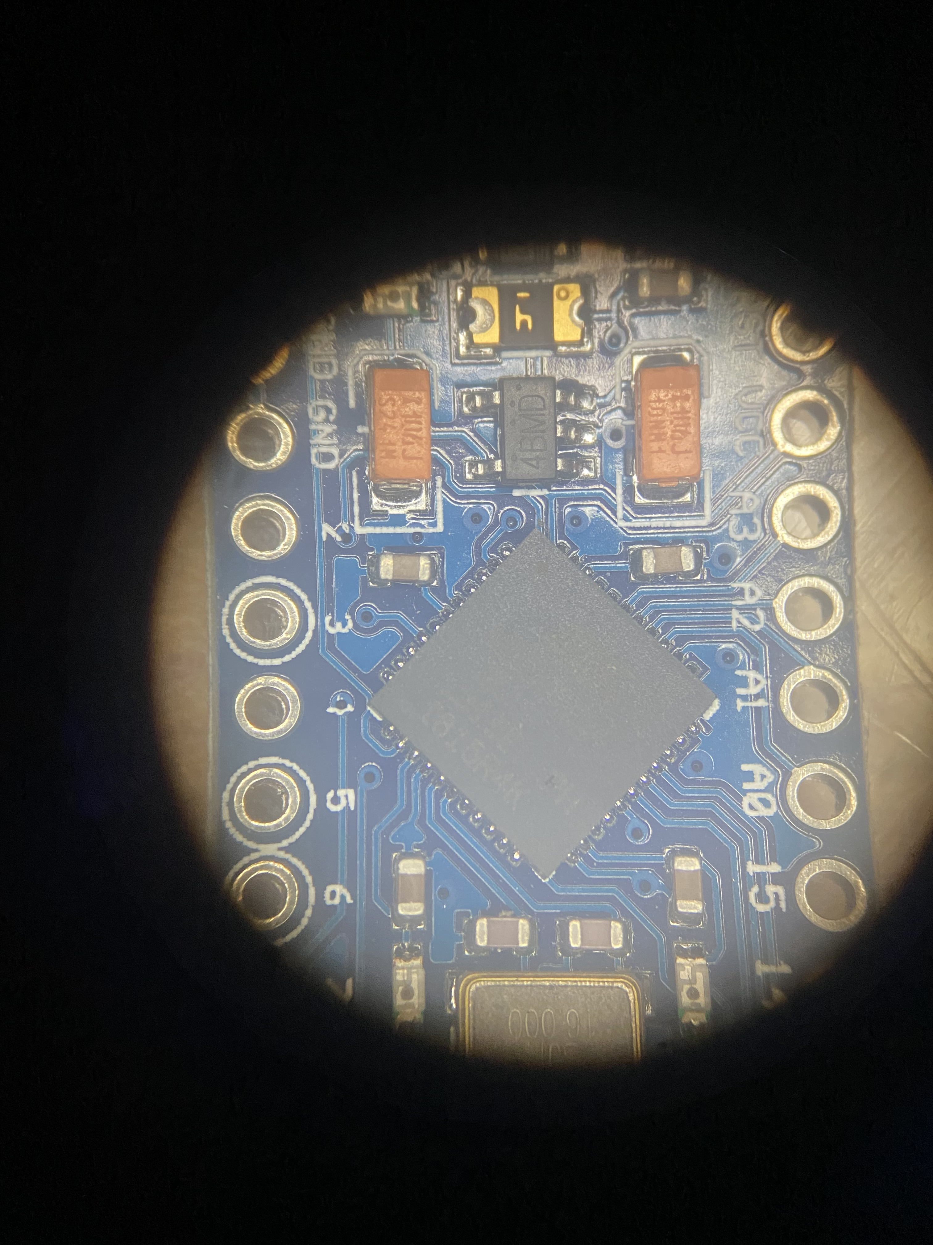
Hardware Assembly

Slide 17
MicroPython:
OTS Hardware Demo

Slide 19
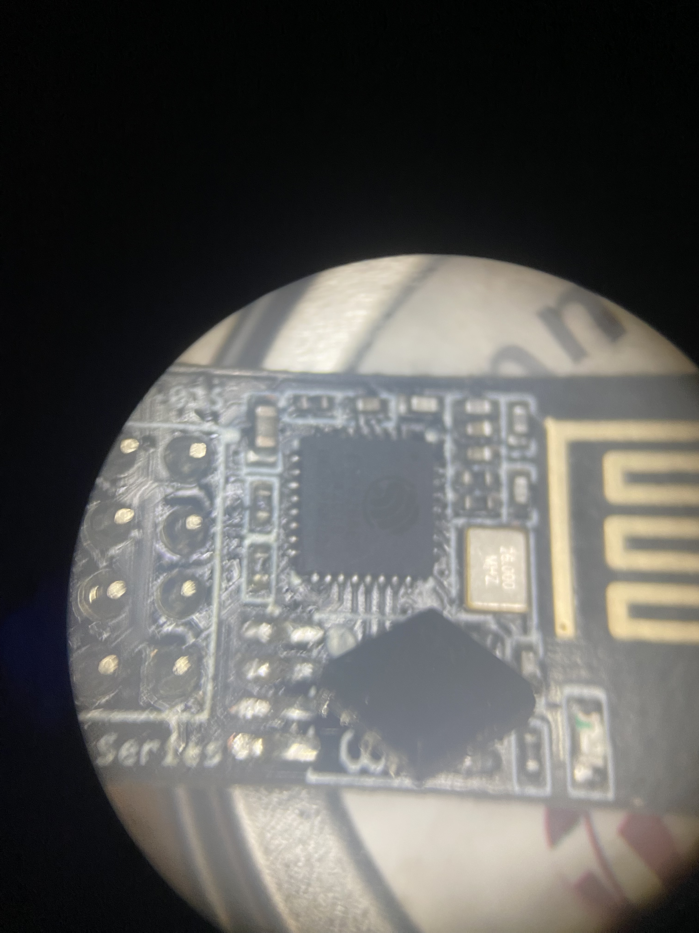
Other Cool stuff
-Esp-01 hack
-TinyML
-Pyscript + MicroPython

Slide 20
SUMMARY
While MicroPython may not be the perfect embedded solution. It allows for rapid prototyping and brings a fresh take to a very stiff code-space. Makers rejoice!​

Slide 21
THANK YOU
Keith Harris
k.harris@sudomail.com
https://www.linkedin.com/in/keith-harris-science/
@keithsfuntimepics

Slide 22
Links
https://dpgeorge.net/
https://dev.to/tkeyo/tinyml-machine-learning-on-esp32-with-micropython-38a6
https://talkpython.fm/episodes/show/325/micropython-circuitpython
https://talkpython.fm/episodes/show/391/pyscript-powered-by-micropython
https://www.pythonpodcast.com/episode-15-damien-george-talks-to-us-about-micropython/
https://datasheets.raspberrypi.com/rp2040/hardware-design-with-rp2040.pdf
https://www.kicad.org/
Hardware Design: https://www.youtube.com/watch?v=kcwvuwetgEQ
https://projects.raspberrypi.org/en/projects/getting-started-with-the-pico/0
https://www.adafruit.com/category/875
https://www.brilliantmonocle.com/
Async: https://www.youtube.com/watch?v=5VLvmA__2v0
Multithread: https://www.youtube.com/watch?v=1q0EaTkztIs
https://makecode.com/blog/one-chip-to-flash-them-all

